Slide 1

Introduction to AI, Spring 2023 Lazy Learning

Slide 2
Fast Recap Questions!
Broadly speaking, what does it mean to train a classifier using supervised learning?
Name something the Naïve Bayes Classifier and Decision Trees, have in common

Slide 3
Fast Recap Questions!
Broadly speaking, what does it mean to train a classifier using supervised learning?
To create/train a model using lots of labeled input data (i.e., examples with labels).
Name something the Naïve Bayes Classifier and Decision Trees have in common
Well, they are all types of classifiers! Once you build your model with training data, you can then give it NEW examples

Slide 4
Eager vs. Lazy Learning
So far, the machine learning techniques we’ve covered are called eager learners.
The Naïve Bayes Classifier, decision trees, etc.
They build a model of the function being learned.
The function that applies labels to inputs.
Building the model is expensive, but then you have it! And then you can use it to classify lots of new examples cheaply!

Slide 5
Eager vs. Lazy Learning
Lazy Learners, as you may guess, are kind of the opposite.
They don’t build a model! You don’t figure out the function!
The computation happens when you want to classify an example (which makes classification more expensive).

Slide 6
Citrus vs. Melon
Time for yet another new area!
We’ve classified Coffee…
And Tennis…
Now let’s classify fruit!
We will figure out if any given example is a Citrus or a Melon

Slide 7
Citrus vs. Melon
Just so that we are on the same page (these pictures are just for us, we aren’t doing a computer vision problem right now).
Here are Melons:
Notes:
http://invorma.com/15-varieties-of-melons-with-pictures/

Slide 8
Citrus vs. Melon
And here are fruit that are Citrus

Slide 9
Citrus vs. Melon
Say we had some number of judges taste different kinds of fruits (that were either Citrus or Melons), and the judges agreed on a score for…
How sweet the fruit is
How sour the fruit is.
Now, given new, unknown fruits, you need to classify it based on its taste!
i.e., based on how sweet and sour it is, you need to label it as either citrus or melon.

Slide 10
Fruit Data Set
Here is the data the judges provided us with:
Fruit | Sweet | Sour | Type
Lemon | 1 | 5 | Citrus
Lime | 1 | 6 | Citrus
Grapefruit | 2 | 5 | Citrus
Cantaloupe | 4 | 2 | Melon
Orange | 4 | 3 | Citrus
Honeydew | 5 | 1 | Melon
Watermelon | 6 | 1 | Melon

Slide 11
Fruit Data Set
And when we are working with two numeric attributes like this, we can plot them on a graph!
Fruit | Sweet | Sour
Lemon | 1 | 5
Lime | 1 | 6
Grapefruit | 2 | 5
Cantaloupe | 4 | 2
Orange | 4 | 3
Honeydew | 5 | 1
Watermelon | 6 | 1
Doing some color-coding here.
Green means it was labelled as “Citrus”
Red means it was labelled as “Melon”
Sour
Sweet

Slide 12
k Nearest Neighbor
So here is the lazy learning algorithm we’ll learn today: k Nearest Neighbor! (KNN)
We get a new example (we know it’s sweetness and sourness, but not it’s label).
We plot it on our graph.
We look at its neighbors (i.e., the other examples it is close to)
We classify our new example based on the company it keeps!

Slide 13
k Nearest Neighbor
How many neighbors do we look at? Well, k many, of course.
Often you end up in situations where the new example’s neighbors aren’t all the same.
So k, though in theory can be any number, is often odd to avoid ties.
And you classify the new example based on what label the majority of the k neighbors have.

Slide 14
k Nearest Neighbor
When performing KNN, we need to know the following information:
How many dimensions n does the data have? (i.e., how many attributes/features do our examples have)?
How many neighbors will we be looking at (i.e., what is the value of k)?
Which distance function will be used (i.e., how do we measure proximity to neighbors).

Slide 15
Fruit Data Set
So, given this, what might our answers for n, k, and the distance metric be?
(Note, only ‘n’ has a ”correct” answer. The others are “up to us”)
Fruit | Sweet | Sour
Lemon | 1 | 5
Lime | 1 | 6
Grapefruit | 2 | 5
Cantaloupe | 4 | 2
Orange | 4 | 3
Honeydew | 5 | 1
Watermelon | 6 | 1
Sour
Sweet

Slide 16
KNN Example
For this fruit classification example..
Dimensions: n = 2 (two attributes! Sweetness and Sourness!)
Num Neighbors: k = 3 (chosen arbitrarily).
Distance: Euclidean (“straight line distance”) (Manhattan distance could have been a nice choice here too!)

Slide 17
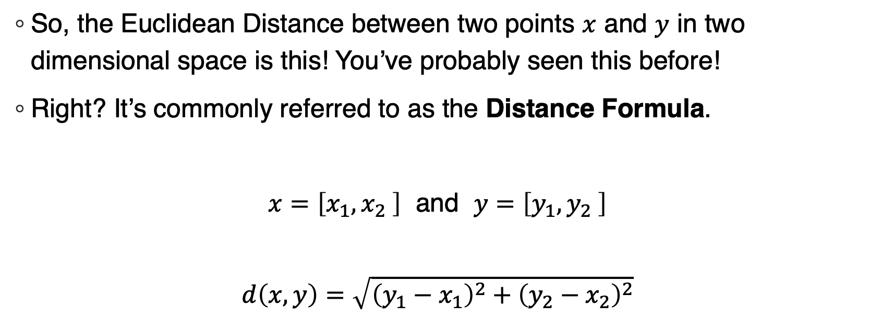
Euclidean Distance
So, the Euclidean Distance between two points $x$ and $y$ in two dimensional space is this! You’ve probably seen this before!
Right? It’s commonly referred to as the Distance Formula.
$x=\left[x_{1},x_{2} \right]$ and $y=\left[y_{1},y_{2} \right]$
$$d\left(x,y\right)=\sqrt{{\left(y_{1}−x_{1}\right)}^{2}+{\left(y_{2}−x_{2}\right)}^{2}}$$

Slide 18
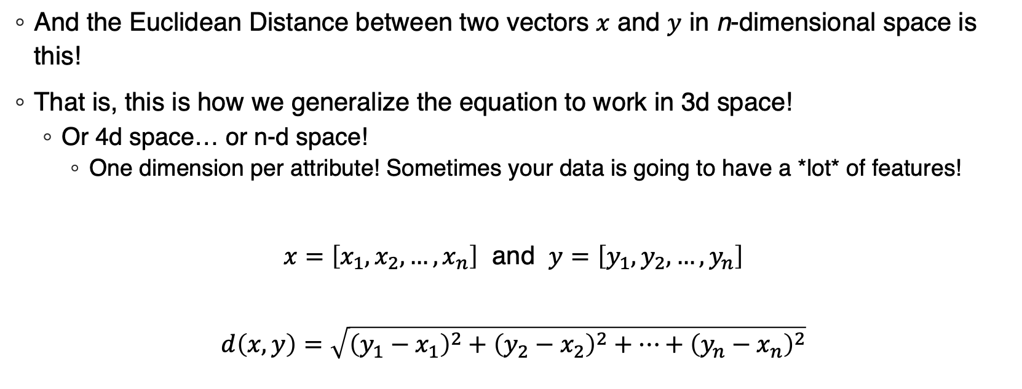
Euclidean Distance
And the Euclidean Distance between two vectors $x$ and $y$ in n-dimensional space is this!
That is, this is how we generalize the equation to work in 3d space!
Or 4d space… or n-d space!
One dimension per attribute! Sometimes your data is going to have a *lot* of features!
$x=\left[x_{1},x_{2},…,x_{n}\right]$ and $y=\left[y_{1},y_{2},…,y_{n}\right]$
$$d\left(x,y\right)=\sqrt{{\left(y_{1}−x_{1}\right)}^{2}+{\left(y_{2}−x_{2}\right)}^{2}+…+{\left(y_{n}−x_{n}\right)}^{2}}$$

Slide 19
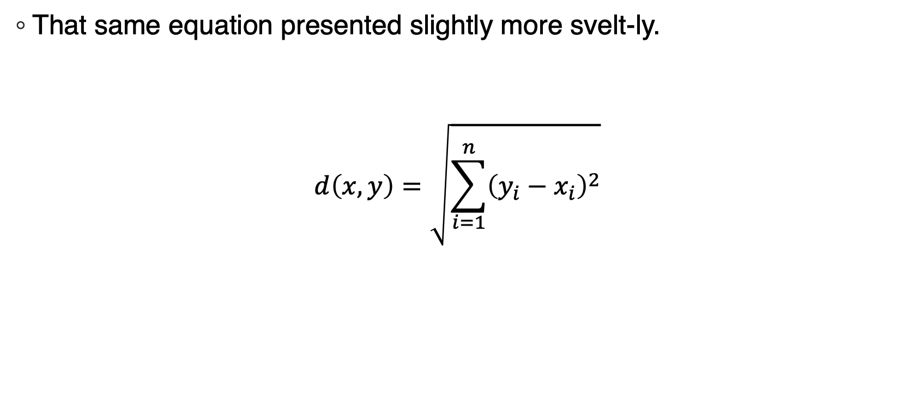
Euclidean Distance
That same equation presented slightly more svelt-ly.
$$d\left(x,y\right)=\sqrt{\sum_{i=1}^{n}{{\left(y_{i}−x_{i}\right)}^{2}}}$$

Slide 20
KNN Example
So, let’s take our previously plotted data, and add a new, unlabeled example to it!
Sour
Sweet

Slide 21
KNN Example
Here’s the new example, colored in ‘blue’ down there at (4,1).
This is what we know about the new example:
Index: Santa Claus Melon
Sweetness = 4
Sourness = 1
Label = ??????????
Sour
Sweet

Slide 22
KNN Example
And. Uh. Yes, the index DOES have the word Melon in it…
But we can’t just trust that! That’s just a name! We’ll figure out what it is with SCIENCE!
This is what we know about the new example:
Index: Santa Claus Melon
Sweetness = 4
Sourness = 1
Label = ??????????
Sour
Sweet

Slide 23
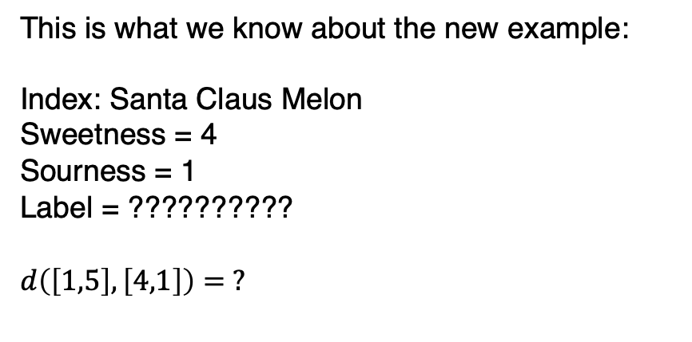
KNN Example
So we’ve plotted our new, unlabeled example.
We now need to compute the distance from that new example to every other previous example we have.
This is what we know about the new example:
Index: Santa Claus Melon
Sweetness = 4
Sourness = 1
Label = ??????????
$$d\left(\left[1,5\right],\left[4,1\right]\right)= ?$$
Sour
Sweet

Slide 24
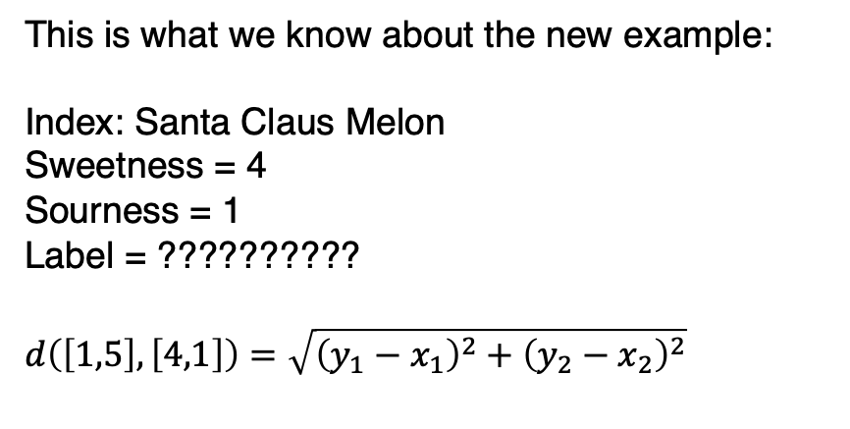
KNN Example
So here we are checking the distance between the new example to that “lower left” green, plotted at (1,5).
That is, we are measuring the distance from (4,1) and (1,5).
This is what we know about the new example:
Index: Santa Claus Melon
Sweetness = 4
Sourness = 1
Label = ??????????
$$d\left(\left[1,5\right],\left[4,1\right]\right)=\sqrt{{\left(y_{1}−x_{1}\right)}^{2}+{\left(y_{2}−x_{2}\right)}^{2}}$$
Sour
Sweet

Slide 25
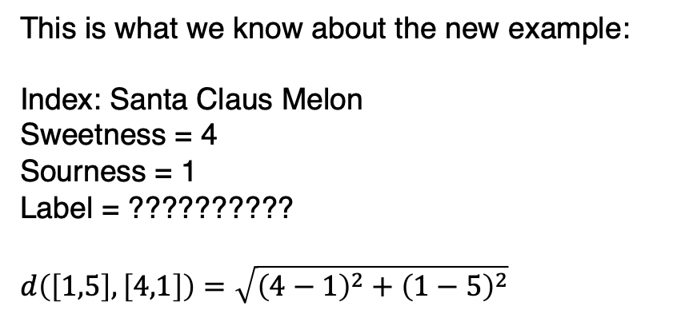
KNN Example
So, we plug that into our distance formula.
This is what we know about the new example:
Index: Santa Claus Melon
Sweetness = 4
Sourness = 1
Label = ??????????
$$d\left(\left[1,5\right],\left[4,1\right]\right)=\sqrt{{\left(4−1\right)}^{2}+{\left(1−5\right)}^{2}}$$
Sour
Sweet

Slide 26
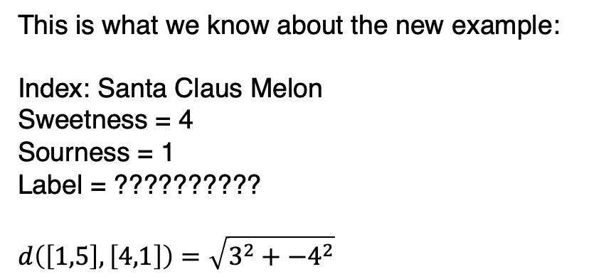
KNN Example
La la, doing math, see the math in the lower right corner of this slide.
This is what we know about the new example:
Index: Santa Claus Melon
Sweetness = 4
Sourness = 1
Label = ??????????
$$d\left(\left[1,5\right],\left[4,1\right]\right)=\sqrt{3^{2}+{−4}^{2}}$$
Sour
Sweet

Slide 27
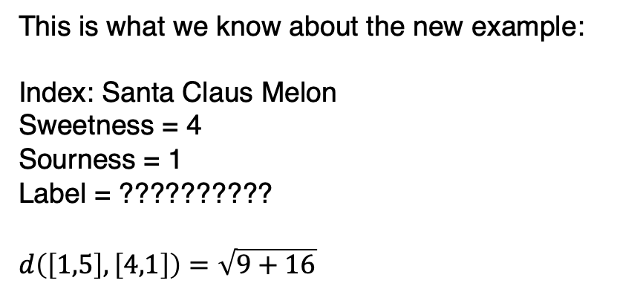
KNN Example
The math continues…
This is what we know about the new example:
Index: Santa Claus Melon
Sweetness = 4
Sourness = 1
Label = ??????????
$$d\left(\left[1,5\right],\left[4,1\right]\right)=\sqrt{9+16}$$
Sour
Sweet

Slide 28
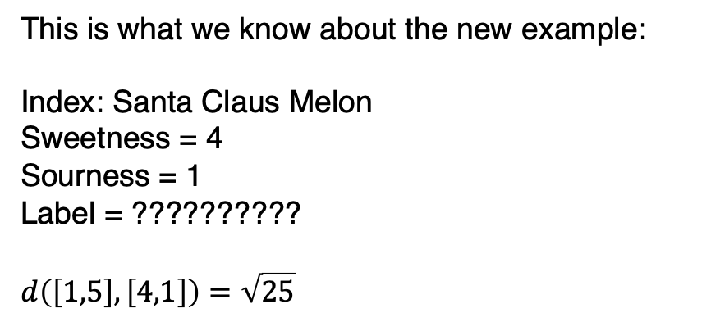
KNN Example
Getting closer…
This is what we know about the new example:
Index: Santa Claus Melon
Sweetness = 4
Sourness = 1
Label = ??????????
$$d\left(\left[1,5\right],\left[4,1\right]\right)=\sqrt{25}$$
Sour
Sweet

Slide 29
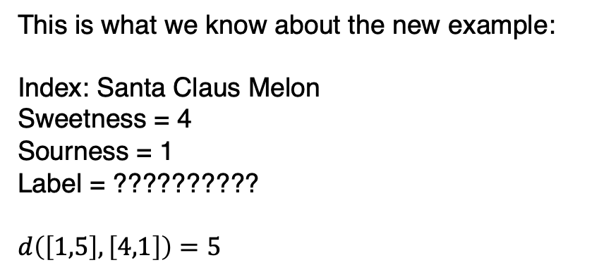
KNN Example
Hey, there we go! The distance between the two points is 5!
That’s one neighbor done!
This is what we know about the new example:
Index: Santa Claus Melon
Sweetness = 4
Sourness = 1
Label = ??????????
$$d\left(\left[1,5\right],\left[4,1\right]\right)=5$$
Sour
5
Sweet

Slide 30
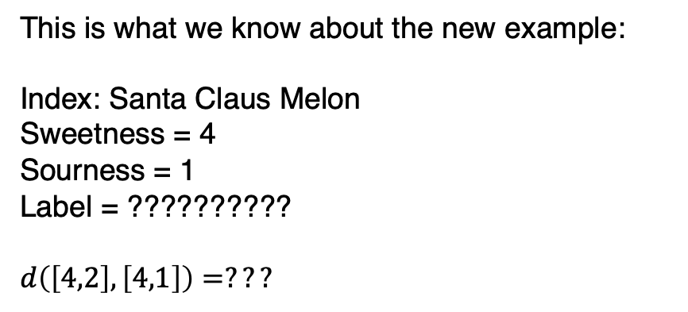
KNN Example
Now we move on to a second neighbor!
Here we’re looking at that red dot at (4,2)
This is what we know about the new example:
Index: Santa Claus Melon
Sweetness = 4
Sourness = 1
Label = ??????????
$$d\left(\left[4,2\right],\left[4,1\right]\right)=???$$
Sour
5
Sweet

Slide 31
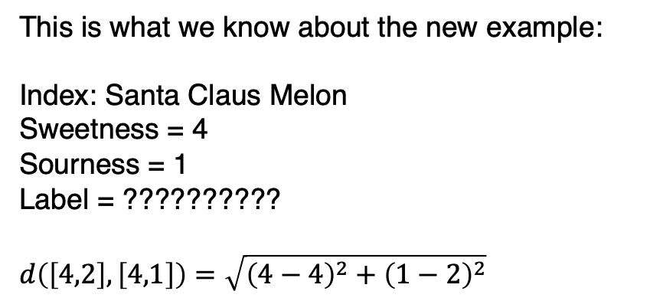
KNN Example
And we use the distance formula again…
This is what we know about the new example:
Index: Santa Claus Melon
Sweetness = 4
Sourness = 1
Label = ??????????
$$d\left(\left[4,2\right],\left[4,1\right]\right)=\sqrt{{\left(4−4\right)}^{2}+{\left(1−2\right)}^{2}}$$
Sour
5
Sweet

Slide 32
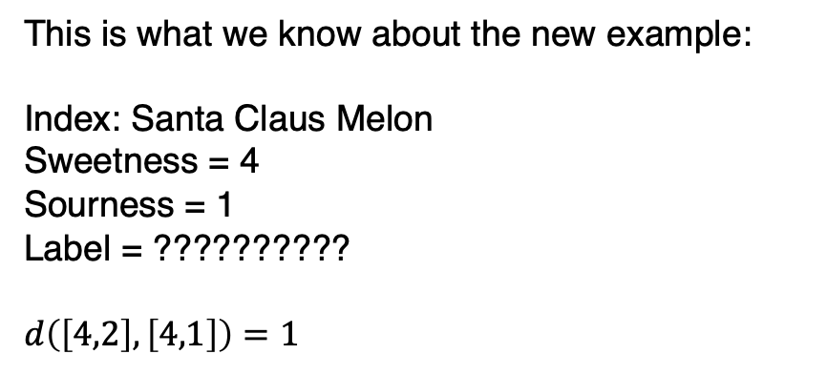
KNN Example
And we discover that the distance between these guys is 1!
Great! Two down!
This is what we know about the new example:
Index: Santa Claus Melon
Sweetness = 4
Sourness = 1
Label = ??????????
$$d\left(\left[4,2\right],\left[4,1\right]\right)=1$$
Sour
5
1
Sweet

Slide 33
KNN Example
Let’s just skip ahead and say we did all of them. We now know the distances between our new example and every existing labelled example.
This is what we know about the new example:
Index: Santa Claus Melon
Sweetness = 4
Sourness = 1
Label = ??????????
$$d\left(\left[4,2\right],\left[4,1\right]\right)=1$$
Sour
Sweet

Slide 34
KNN Example
So now we can figure out the three nearest neighbors! It’s the three within the dotted line.
Watermelon (at (6,1)) was also d=2, but Orange (at (4,3)) won our tie (arbitrarily).
This is what we know about the new example:
Index: Santa Claus Melon
Sweetness = 4
Sourness = 1
Label = ??????????
The three nearest neighbors:
Cantaloupe (d = 1)
Honeydew (d = 1)
Orange (d = 2)
Sour
Sweet

Slide 35
KNN Example
And we use that to label our new example!
Two neighbors were melons and one was citrus. Melon wins!
This is what we know about the new example:
Index: Santa Claus Melon
Sweetness = 4
Sourness = 1
Label = Melon
Neighbor 1: Cantaloupe (melon)
Neighbor 2: Honeydew (melon)
Neighbor 3: Orange (citrus)
By majority vote (2 for melon 1 for citrus), we classify Santa Clause Melon as a melon!
Sour
Sweet

Slide 36
Distance Metrics
Straight line distance works nicely for physical-distance metaphors.
But if what you are comparing are strings of text, you might use the Hamming Distance.
A form of edit distance. Basically: how many character substitutions to turn one string into another?
Is “cat” closer to “dog” or “hat”? Hamming would say “hat”!
Or if you have strings of numbers, you might use the Pearson Correlation Coefficient.
https://link.springer.com/content/pdf/10.1007%2F978-3-540-85920-8_35.pdf

Slide 37
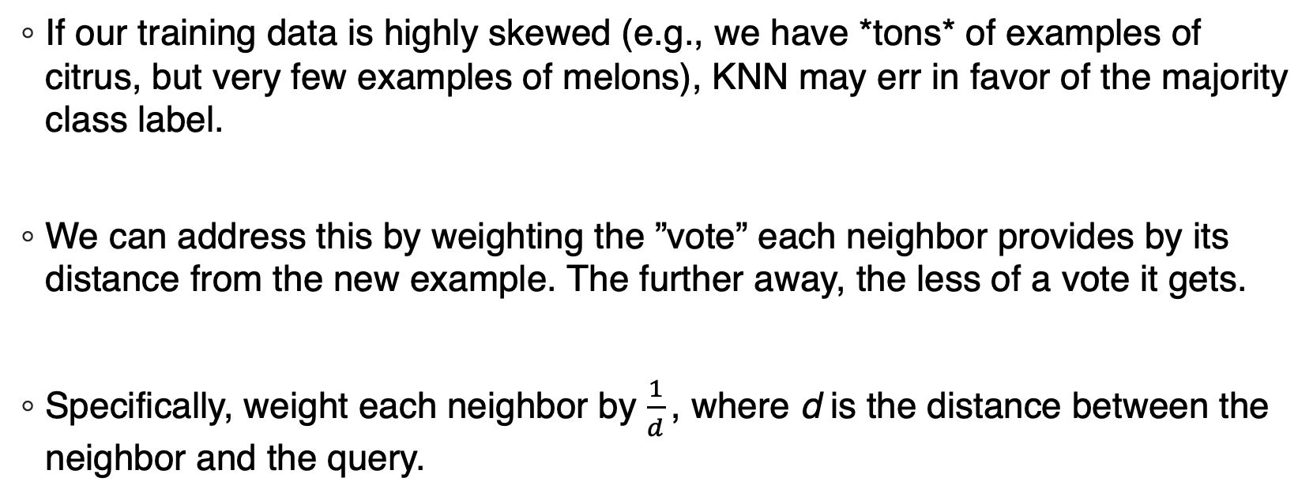
KNN Problems
If our training data is highly skewed (e.g., we have *tons* of examples of citrus, but very few examples of melons), KNN may err in favor of the majority class label.
We can address this by weighting the ”vote” each neighbor provides by its distance from the new example. The further away, the less of a vote it gets.
Specifically, weight each neighbor by $\frac{1}{d}$ , where d is the distance between the neighbor and the query.

Slide 38
KNN Example – Weighting Neighbors
So, to illustrate weighting using our running example…
This is what we know about the new example:
Index: Santa Claus Melon
Sweetness = 4
Sourness = 1
Label = ??????????
The three nearest neighbors:
Cantaloupe (d = 1)
Honeydew (d = 1)
Orange (d = 2)
Sour
Sweet

Slide 39
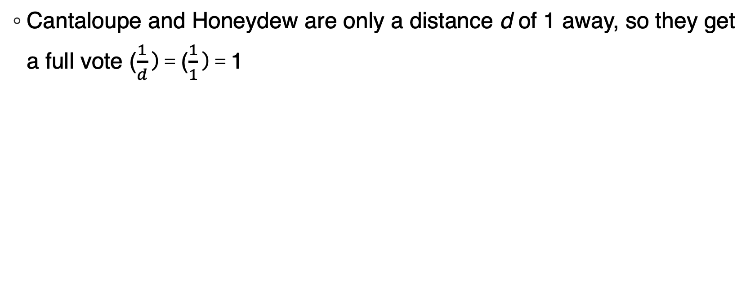
KNN Example – Weighting Neighbors
Cantaloupe and Honeydew are only a distance d of 1 away, so they get a full vote ($\frac{1}{d}$ ) = ($\frac{1}{1}$ ) = 1
This is what we know about the new example:
Index: Santa Claus Melon
Sweetness = 4
Sourness = 1
Label = ??????????
The three nearest neighbors:
Cantaloupe (d = 1): 1/1 vote for Melon
Honeydew (d = 1): 1/1 vote for Melon
Orange (d = 2)
Sour
Sweet

Slide 40
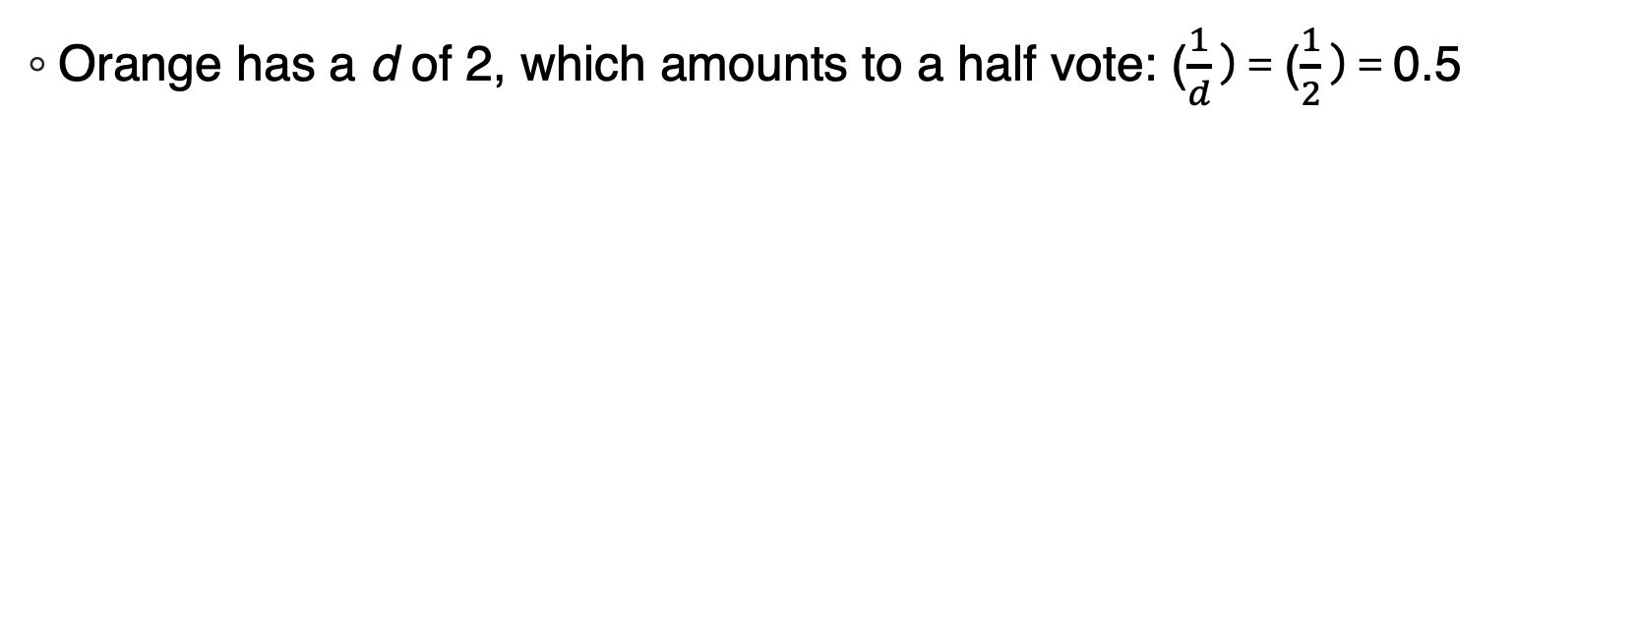
KNN Example – Weighting Neighbors
Orange has a d of 2, which amounts to a half vote: ($\frac{1}{d}$ ) = ($\frac{1}{2}$ ) = 0.5
This is what we know about the new example:
Index: Santa Claus Melon
Sweetness = 4
Sourness = 1
Label = ??????????
The three nearest neighbors:
Cantaloupe (d = 1): 1/1 vote for Melon
Honeydew (d = 1): 1/1 vote for Melon
Orange (d = 2): 1/2 vote for Fruit
Sour
Sweet

Slide 41
KNN Example – Weighting Neighbors
The end result is the same, Santa Claus Melon is a melon, though the vote tallies were slightly different!
This is what we know about the new example:
Index: Santa Claus Melon
Sweetness = 4
Sourness = 1
Label = Melon
By majority vote (2 for melon 0.5 for citrus), we classify Santa Clause Melon as a melon!
Sour
Sweet

Slide 42
KNN Problems
Another problem is that most distance metrics consider all attributes. Because of this, KNN is very sensitive to irrelevant information.
Imagine our dentist example. If we are trying to classify “cavity” or “no cavity”, and our examples have the attributes “catch”, “toothache” and “weather”, the weather is going to have a heavy hand in influencing the classification (when it should really have *no* hand!).

Slide 43
KNN Problems
Or, say, in this fruit example!
If our attributes were “sweetness”, “sourness” and “day of week we conducted the taste test”…
The day of the week would influence classification, when it shouldn’t!
Compare this to, say, decision trees, which naturally were able to identify and use “good” attributes to split on (and, consequently, ignore “bad” ones).
That is, ideally, the decision tree would see that there isn’t a pattern connecting “day of week” and the class label, and thus the day of the week would never be selected to be used as a node!

Slide 44
Lazy Learning Tradeoffs
Good Things:
No training needed!
No time spent training!
No memory taken up by a model!
Incorporating new training data is easy! You don’t have to re-build the model from scratch each time you get new labelled data!
Bad Things:
Every time we want to classify something, we need to perform the distance calculation for every example in the training database. This makes the actual act of classification expensive in terms of time and memory, relative to eager techniques
Though there are tricks to avoid having to test *every* example.

